Slide 1
第四章 光栅化算法
Notes:
思考：
高级语言有什么一般特性？
如何设计编译器来应对这种特性？
1hour +5min

Slide 2
本章内容
4.1 图形生成算法
4.2 区域填充算法
4.3 剪裁算法
4.4 消隐算法

Slide 3
剪裁算法

Slide 4
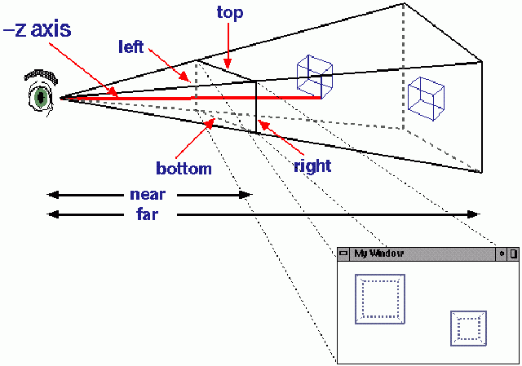
Viewing Frustum
视见体：世界空间中将被裁剪
出来并投影到视图平面的那一
部分定出边界

Slide 5
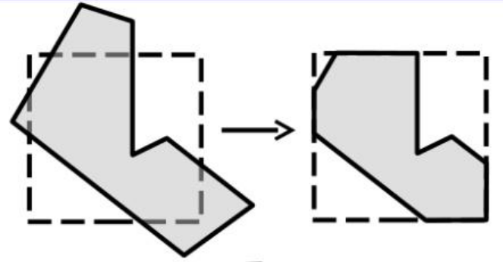
Viewing Frustum
剪裁算法：需要确定图形中哪些部分落在显示区之内，哪些落在显示区之外，一般只显示落在显示区内部的图形，这个选择过程称为裁剪。

Slide 6
二维直线剪裁算法
Sutherland-Cohen Algorithm
Step 1. Whether a line segment fall into the viewing region
Step 2. Display the part inside the viewing region

Slide 7
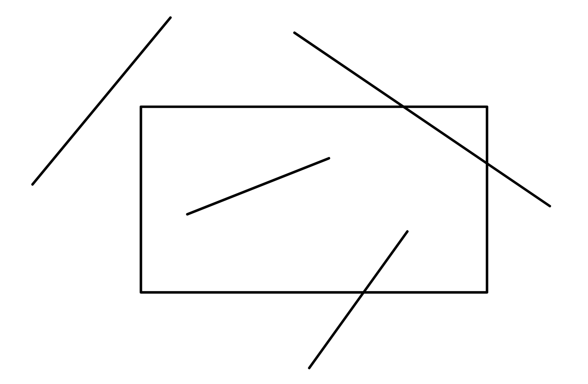
Sutherland-Cohen Algorithm
Are the line segments inside the viewing region?
Only 4 cases!

Slide 8
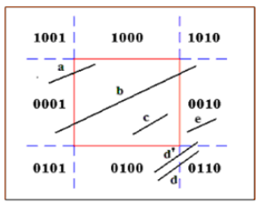
Sutherland-Cohen Algorithm
9 regions with binary codes
Query the code for each endpoint
Two codes are 0000 and 0000
“AND” operation and obtain 0000
X Otherwise
Go to Step 2!

Slide 9
Sutherland-Cohen Algorithm
Step 2. Find the part of segment inside the viewing region
Query the horizontal/vertical line
Compute the intersection point
Repeat step 1
Example: line b

Slide 10
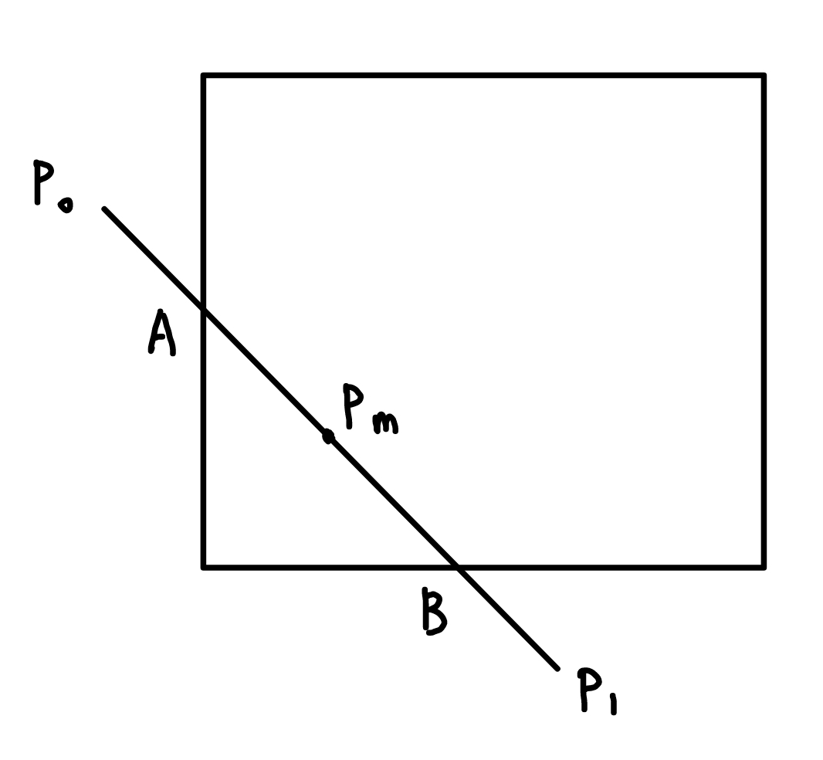

How to find the intersection points?
$y=y_{0}+k(x−x_{0})$?
Another method: test the midpoint, select the part with intersections, and then repeat
Too much computation!
Easy with hardware

Slide 11





Liang-Barskey Algorithm
Which part of the line segment is visible?
$x_{l}≤x_{1}+u∆x≤x_{r}$
$y_{b}≤y_{1}+u∆y≤y_{t}$
$∆x=x_{2}−x_{1}$, $∆y=y_{2}−y_{1}$
$$y_{t}$$
$$y_{b}$$
$$x_{l}$$
$$x_{r}$$

Slide 12

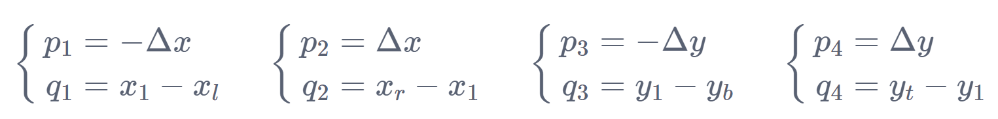

Liang-Barskey Algorithm
Rewrite as
$p_{k}<0$: start point.
$p_{k}>0$: start point.
$$y_{t}$$
$$y_{b}$$
$$x_{l}$$
$$x_{r}$$

Slide 13
Let’s go to 3D...
Not only left, right, bottom ,top
What about near and far?

Slide 14
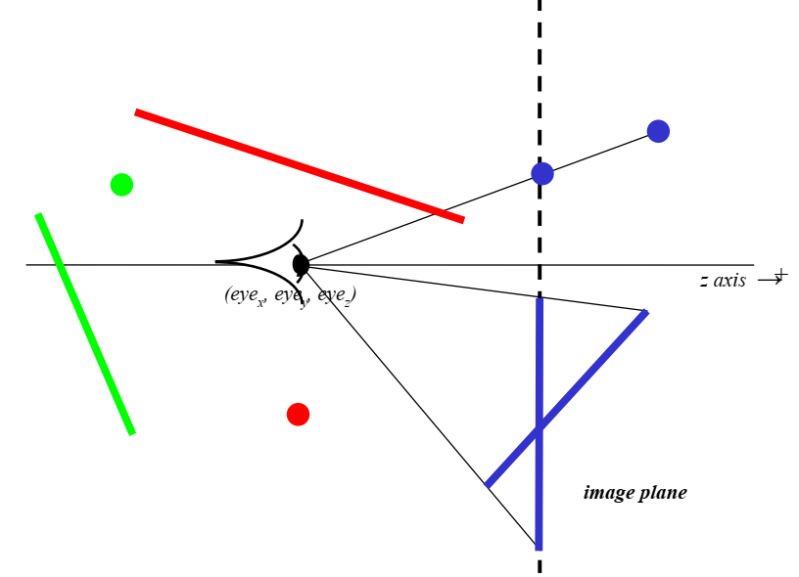
If p_{z} is > eye_{z}?

Slide 15
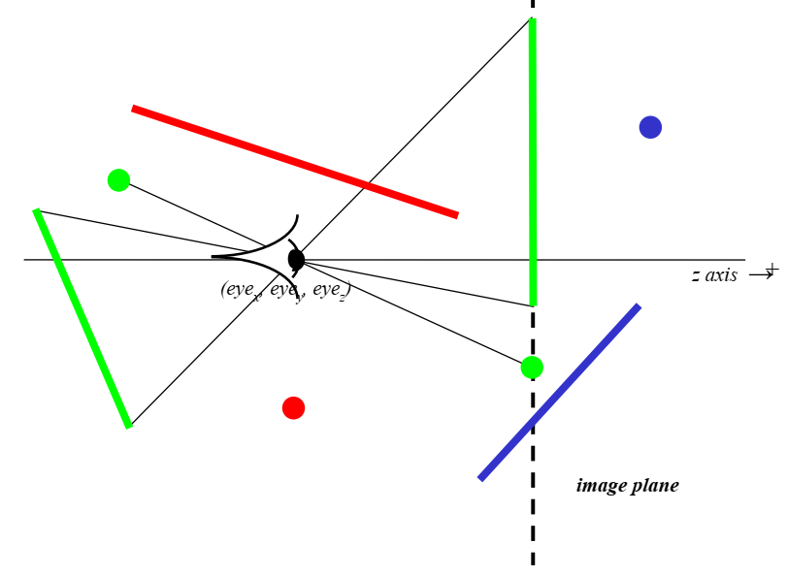
If p_{z} is < eye_{z}?

Slide 16
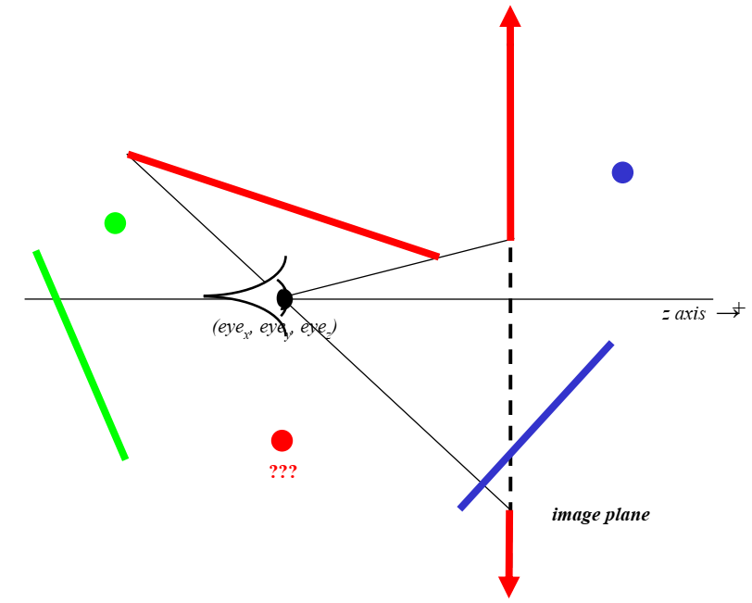
If p_{z} is = eye_{z}?

Slide 17
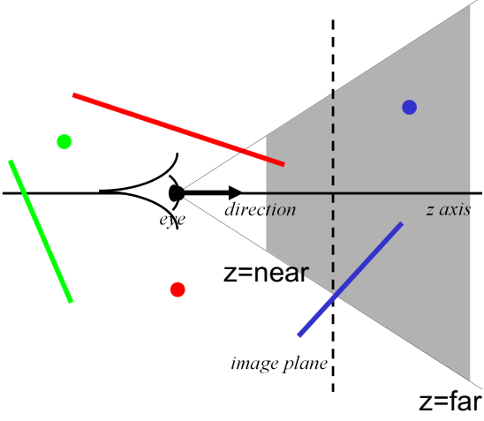
Why clipping?
Avoid degeneracies
Don’t draw stuff behind the eye
Avoid division by 0 and overflow

Slide 18
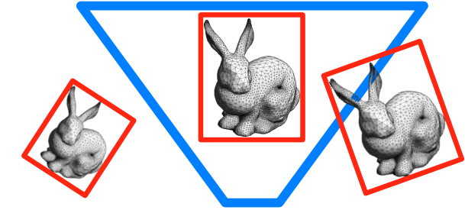
Straightforward Processing
“View Frustum Culling”
Use bounding volumes/hierarchies to test whether any part of an object is within the view frustum
Need “frustum vs. bounding volume” intersection test
Crucial to do hierarchically when scene has lots of objects!
Early rejection (different from clipping)

Slide 19
Homogeneous Rasterization
Idea: avoid projection (and division by zero) by performing rasterization in 3D
Or equivalently, use 2D homogenous coordinates (w’=z after the projection matrix, remember)
Marc Olano, Trey Greer: Triangle scan conversion using 2D homogeneous coordinates, Proc. ACM SIGGRAPH/Eurographics Workshop on Graphics Hardware 1997

Slide 20
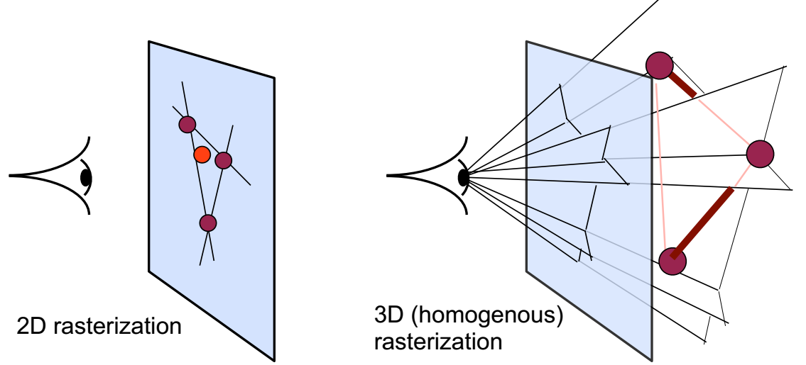
Homogeneous Rasterization
Replace 2D edge equation by 3D plane equation
Plane going through 3D edge and viewpoint
Still a halfspace, just 3D

Slide 21
Homogeneous Rasterization
Treat pixels as 3D points (x, y, 1) on image plane, test for containment in 3 halfspaces just like edge functions

Slide 22
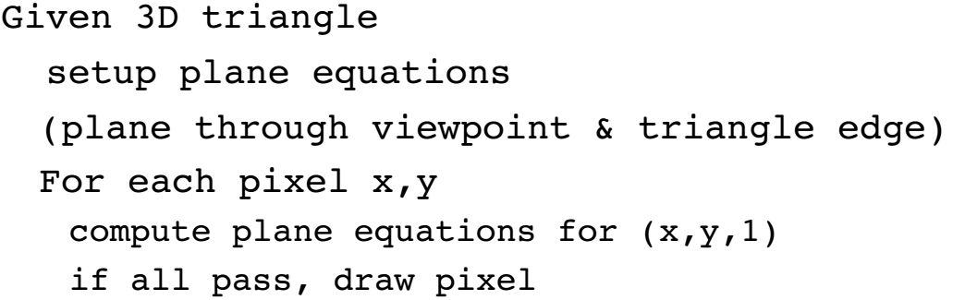
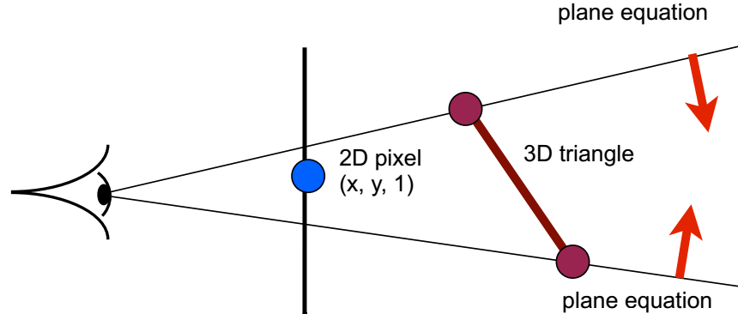
Homogeneous Rasterization

Slide 23
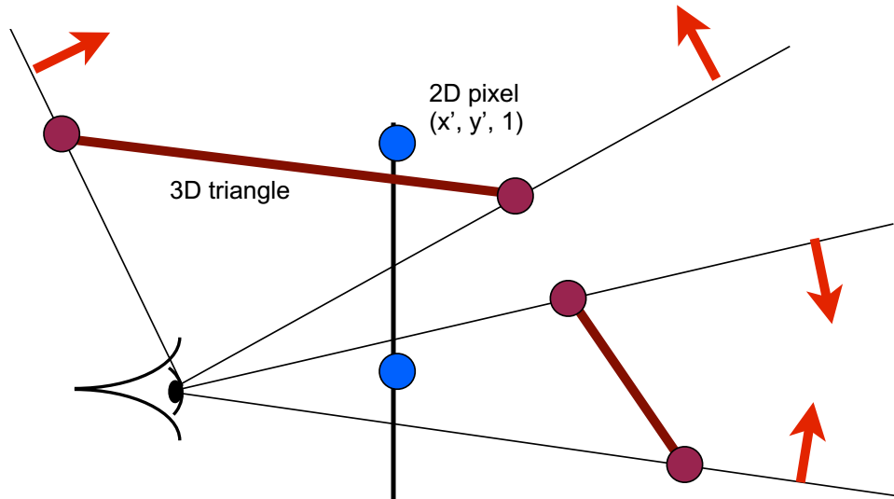
Homogeneous Rasterization
Works for triangles behind eye
Still linear, can evaluate incrementally/hierarchically like 2D

Slide 24
Homogeneous Rasterization
Rasterizes with plane tests instead of edge tests
Removes the need for clipping!

Slide 25
消隐算法

Slide 26
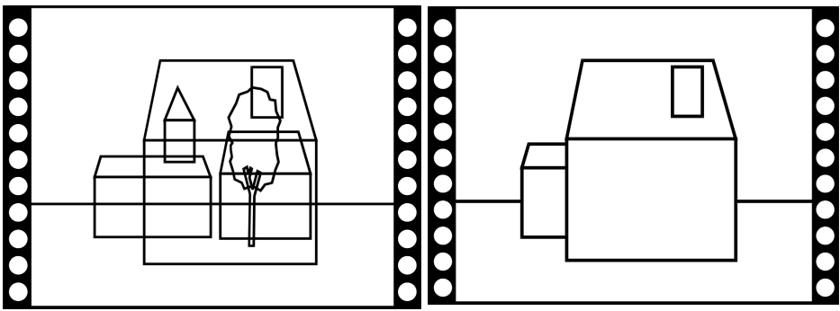
Visibility
How do we know which parts are visible/in front?

Slide 27
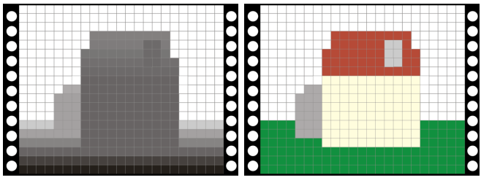
Z-buffer
In addition to frame buffer (R, G, B)
Store distance to camera (z-buffer)
Pixel is updated only if newz is closer than z-buffer value

Slide 28
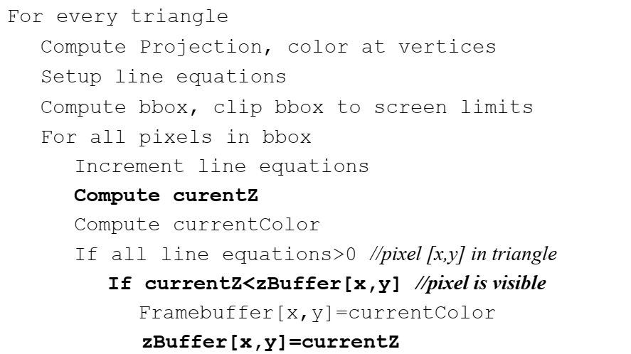
Z-buffer pseudo code

Slide 29
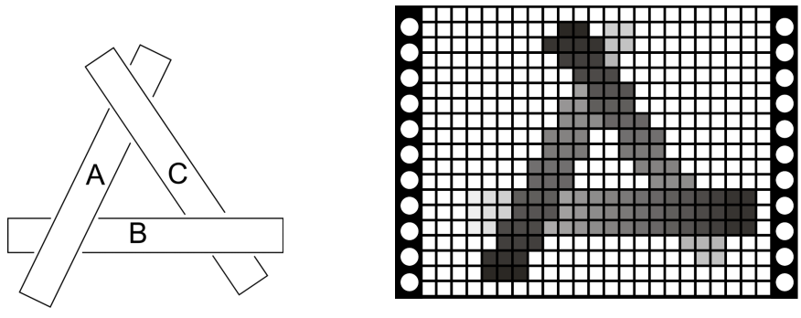
Works for hard cases!

Slide 30
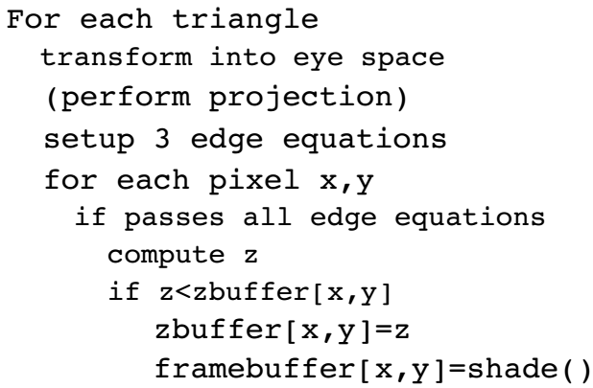
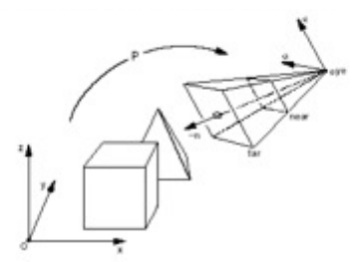
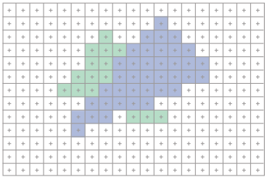
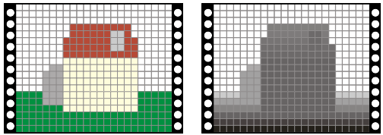
Modern Graphics Pipeline

Slide 31
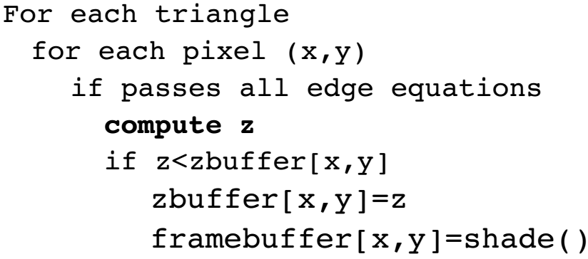
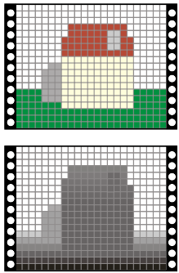
Interpolation in Screen Space
How do we get that Z value for each pixel?
We only know z at the vertices…
(Remember, screen-space z is actually z’/w’)
Must interpolate from vertices into triangle interior

Slide 32
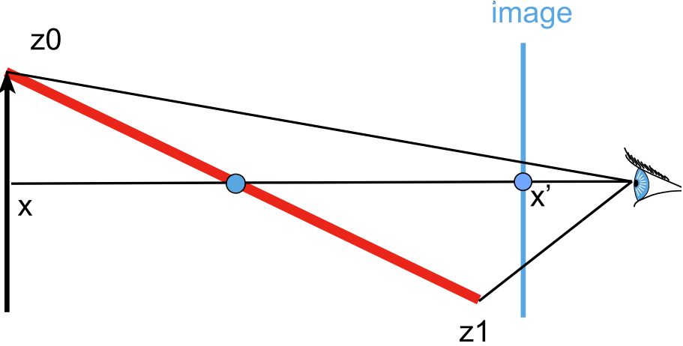
Interpolation in Screen Space
Problem: Linear variation in world space does not yield linear variation in screen space due to projection

Slide 33
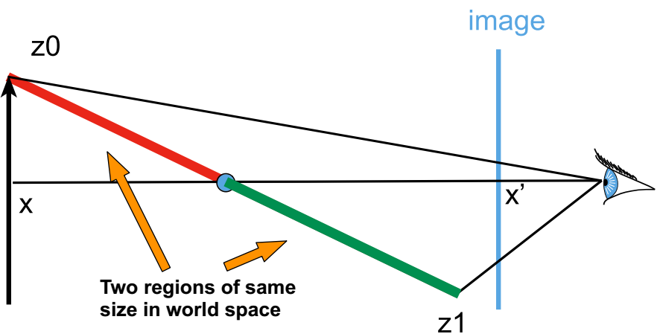
Interpolation in Screen Space
Problem: Linear variation in world space does not yield linear variation in screen space due to projection

Slide 34
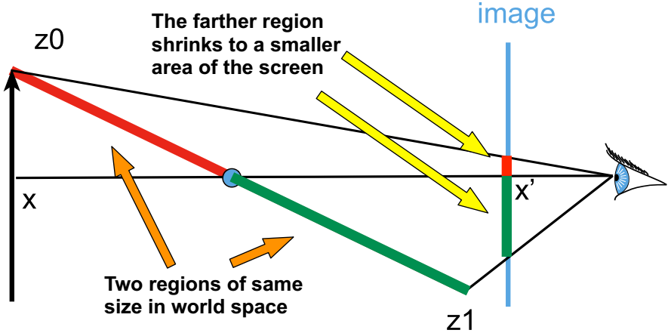
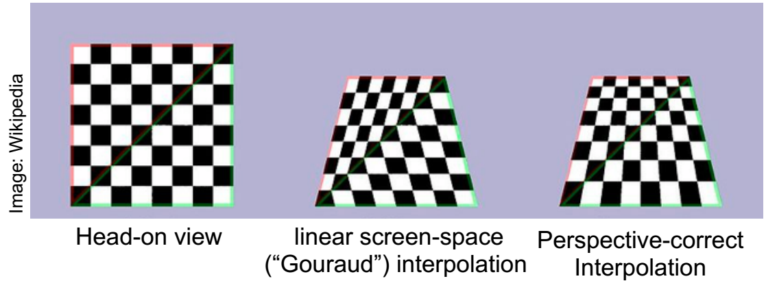
Interpolation in Screen Space
Problem: Linear variation in world space does not yield linear variation in screen space due to projection
Checkerboard Example

Slide 35
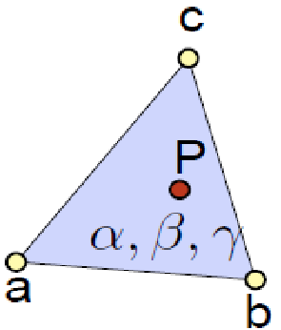
Interpolation in Screen Space
Solution: Barycentrics
Barycentric coordinates for a triangle (a, b, c)
Remember,
Barycentrics are very general:
Work for x, y, z, u, v, r, g, b
Anything that varies linearly in object space
including z

Slide 36
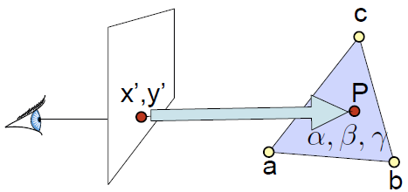
Interpolation in Screen Space
Solution: Barycentrics
Basic strategy
Given screen-space x’, y’
Compute barycentric coordinates
Interpolate anything specified at the three vertices

Slide 37
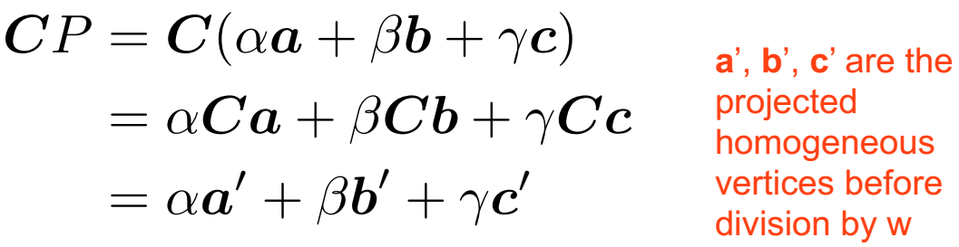
From barycentric to screen-space
Let’s project point P by projection matrix C
Seems to suggest it’s linear in screen space. But it’s homogenous coordinates

Slide 38
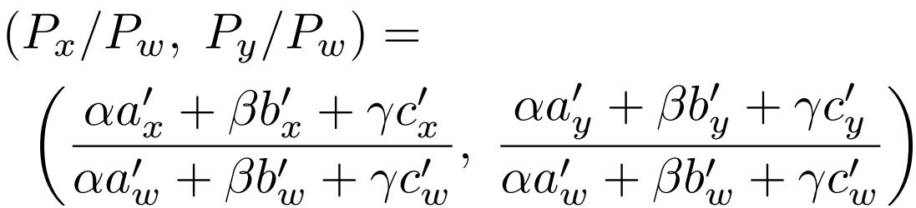
From barycentric to screen-space
After division by w, the (x, y) screen coordinates are
But our goal is, given x, y, to compute α, β, γ

Slide 39
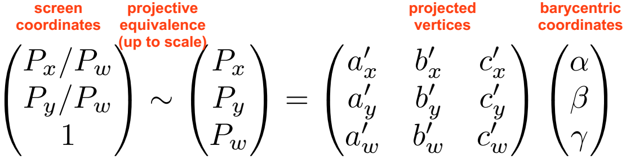
From barycentric to screen-space
The inverse of a projection is a projection…
We’ll just take the inverse mapping to get from (x, y, 1) to the barycentrics!

Slide 40
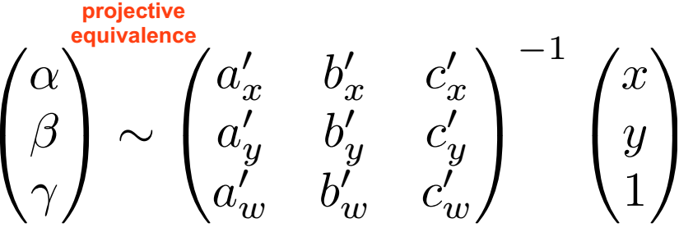
From barycentric to screen-space
Recipe
Compute projected homogeneous coordinates a’, b’, c’
Put them in the columns of a matrix, invert it
Multiply screen coordinates (x, y, 1) by inverse matrix
Then divide by the sum of the resulting coordinates
This ensures the result is sums to one like barycentrics
Then interpolate value (e.g. Z) from vertices using them!

Slide 41
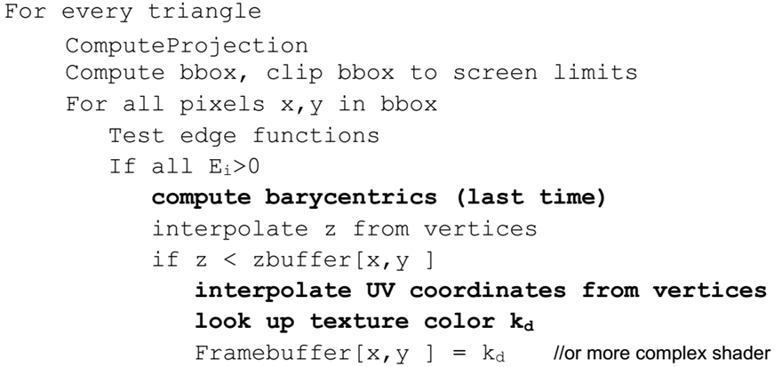

Rasterization becomes...

